Slide 1
Developing Filters and Listeners

Slide 2

Servlet Filters and Listeners
- Servlets and JSPs are used for
presentation
control
Overview
Filters are interceptors
introduces qualities of service
and modify the behavior
Listeners are observers
Do not modify behavior
React to lifecycle and state changes
Used to monitor and observer

Slide 3
Servlet Filters

Slide 4





Web Application
WAR
Filter
Servlet
JSP
HTML
Filter
Servlet
JSP
PNG

Slide 5
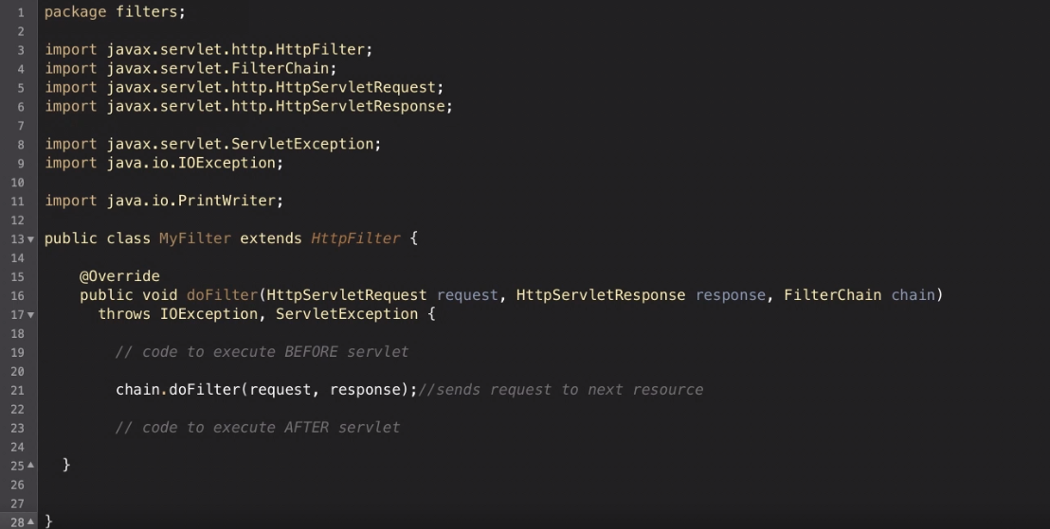

Slide 6
Example Filters Types
Authentication
Data Compression
Logging
Tokenizing
Encryption
Validation

Slide 7
Servlet Filters
Log Filter
Auth Filter
Zip Filter

Slide 8








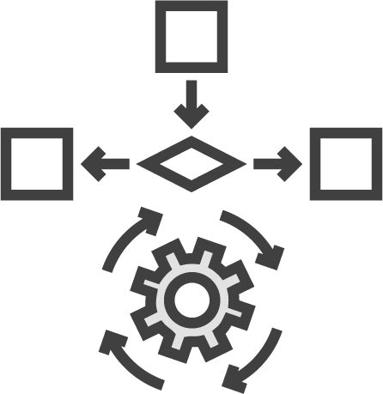




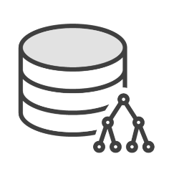





Tomcat Valves
Web Clients
Tomcat
Resources
Coyote
Catalina
Jasper
Web-Apps
JSP

Slide 9






Tomcat Valves
Web Clients
Tomcat
Resources
Coyote
Catalina
Jasper
Web-Apps
JSP

Slide 10
Servlet Filters
Log Filter
Auth Filter
Zip Filter

Slide 11
Servlet Filters
Filter 1
Filter 2
Filter 3

Slide 12
Servlet Filter Chain
Catalina
Filter 1
Filter 2
Filter 3
Servlet
doFilter
"
"
Filter 1-B"
doFilter
Filter 2-B"
doFilter
"Filter 3-B"
doGet
"
"
"TheServlet"
doFilter
"Filter 3-A
doFilter
"Filter 2-A
doFilter
"Filter 1-A
"

Slide 14
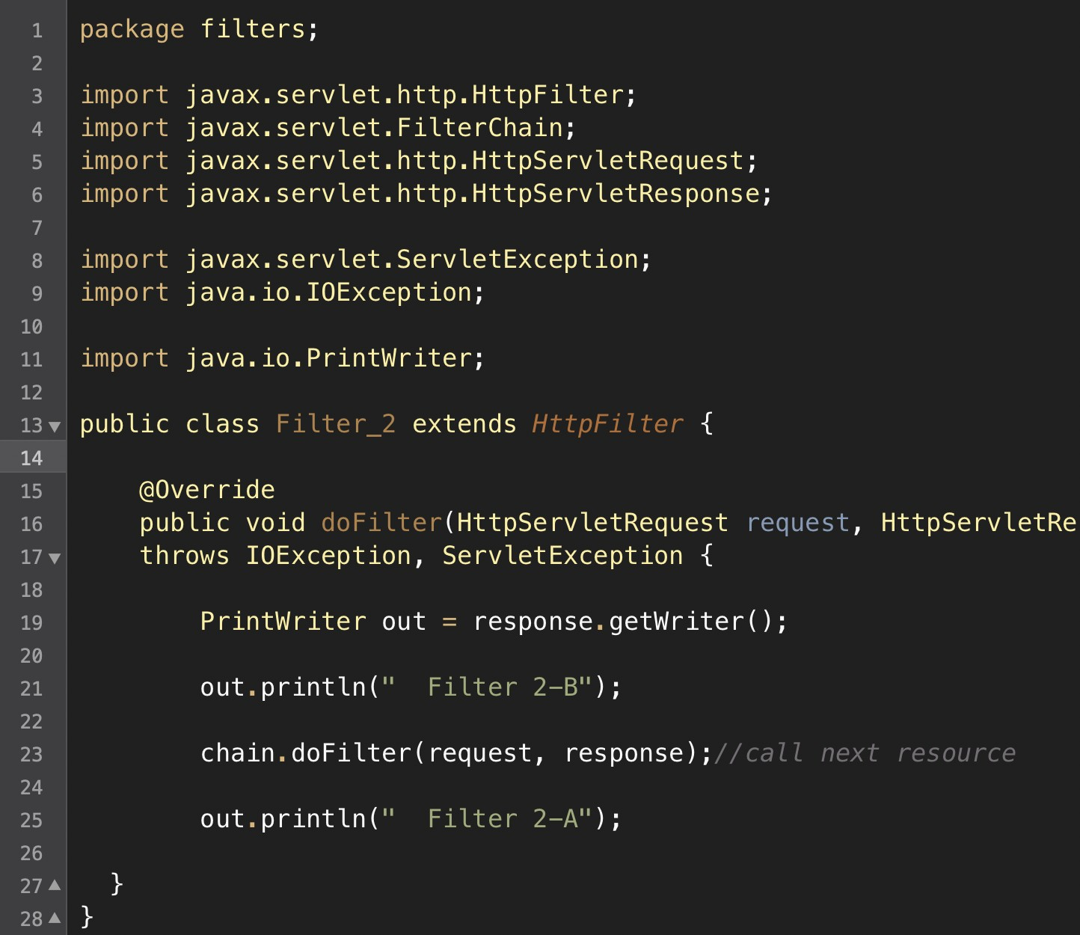

Slide 15
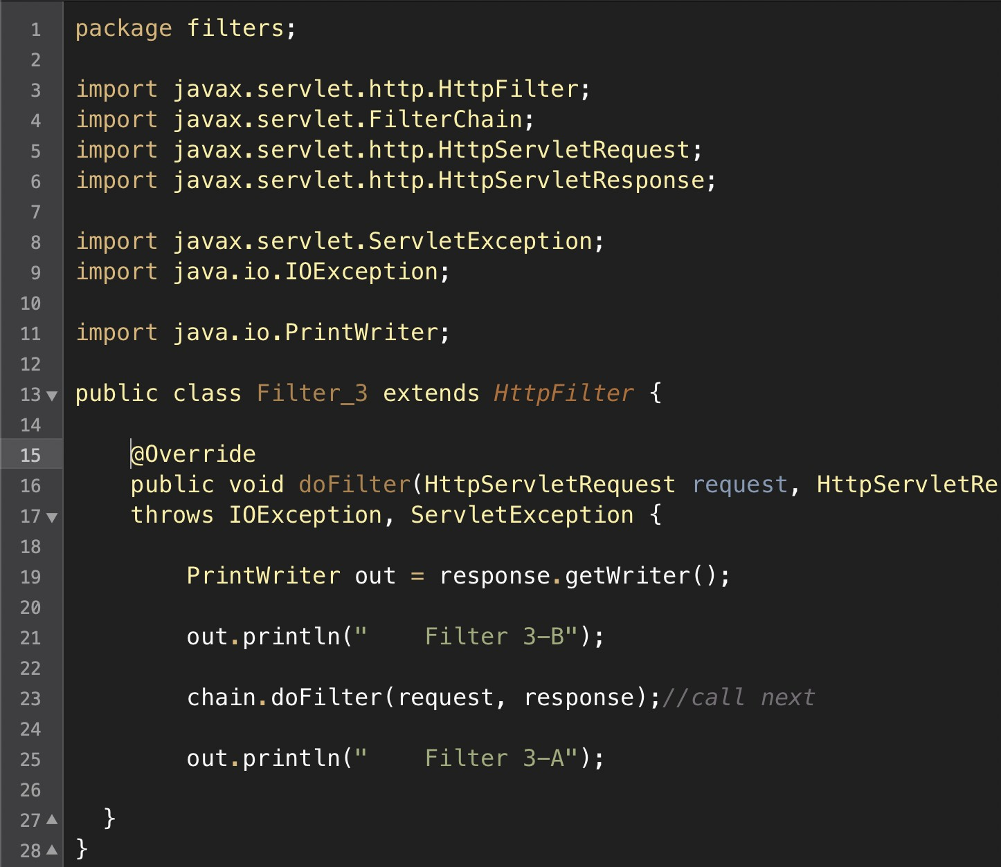

Slide 16
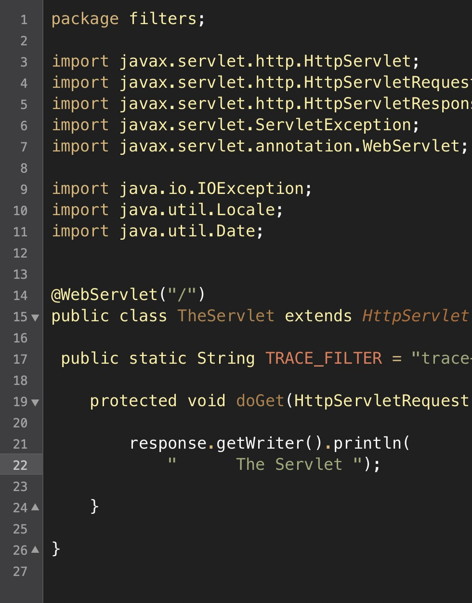

Slide 17
Servlet Filter Chain
Catalina
Filter 1
Filter 2
Filter 3
Servlet
doFilter
"
"
Filter 1-B"
doFilter
Filter 2-B"
doFilter
"Filter 3-B"
doGet
"
"
"TheServlet"
doFilter
"Filter 3-A
doFilter
"Filter 2-A
doFilter
"Filter 1-A
"

Slide 18
Application Event Listeners

Slide 19
Application Events and Listeners
Servlet Context Listeners HTTP Session Listeners Servlet Request Listeners
Lifecycle Events
ServletContextListener
HttpSessionListener
HttpSessionActivation Listener
ServletRequestListener
AsyncListener
State Change Events
ServletContextAttribute Listener
HttpSessionAttribute Listener
HttpSessionIdListener
HttpSessionBinding Listener
ServletRequestAttribute Listener

Slide 20
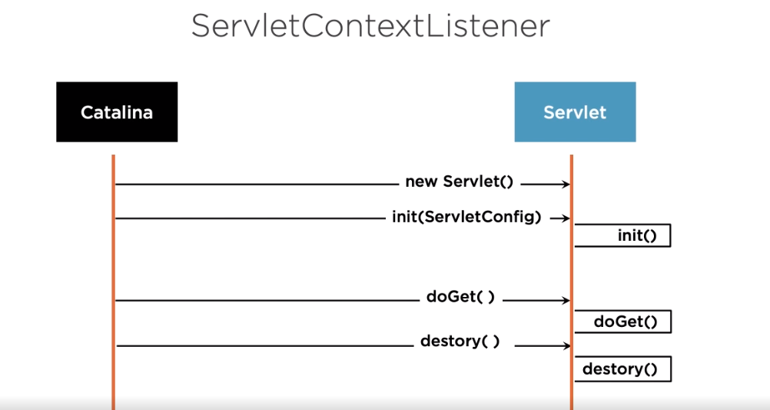

Slide 21
ServletContextListener
Catalina
Servlet
new Servlet()
init(ServletConfig)
init()
doGet( )
doGet()
destory( )
destory()

Slide 22
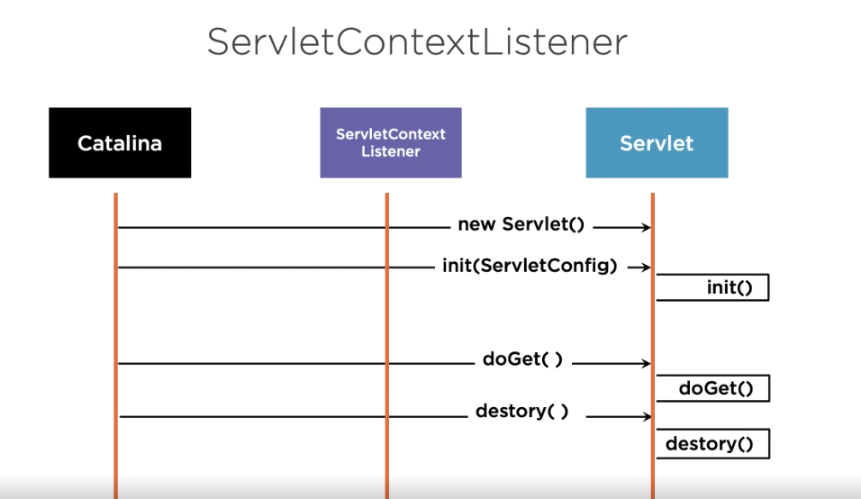

Slide 23
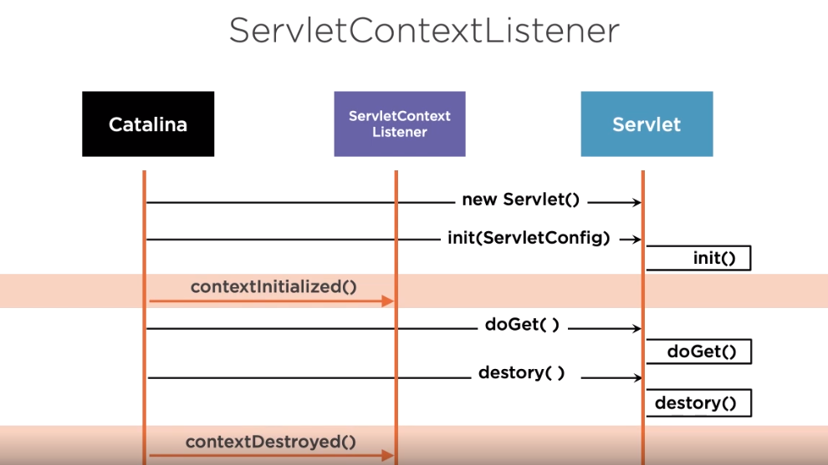

Slide 24
Application Events and Listeners
Servlet Context Listeners HTTP Session Listeners Servlet Request Listeners
Lifecycle Events
ServletContextListener
HttpSessionListener
HttpSessionActivation Listener
ServletRequestListener
AsyncListener
State Change Events
ServletContextAttribute Listener
HttpSessionAttribute Listener
HttpSessionIdListener
HttpSessionBinding Listener
ServletRequestAttribute Listener

Slide 25
Servlet Filters and Listeners
- Servlet Filters are interceptors
HTTP Requests & Responses
Used for
Authentication, data Compression, logging, tokenizing, encryption, and validation
Summary
Servlet Listeners are observers
Lifecycle and state change events
Servlet Context
HTTP Session
HTTP Requests

Slide 26
ServletContextListener
Catalina
ServletContext Listener
Servlet
new Servlet()
init(ServletConfig)
init()
contextInitialized()
doGet( )
doGet()
destory( )
destory()
contextDestroyed()

